Slide 1
Code Samurai -2024
Phase 2
Team: RUET_UNKNOWNS
Team members:
Khandoker Sefayet Alam,
Nazib Abrar, Nafis Ahmed

Slide 2
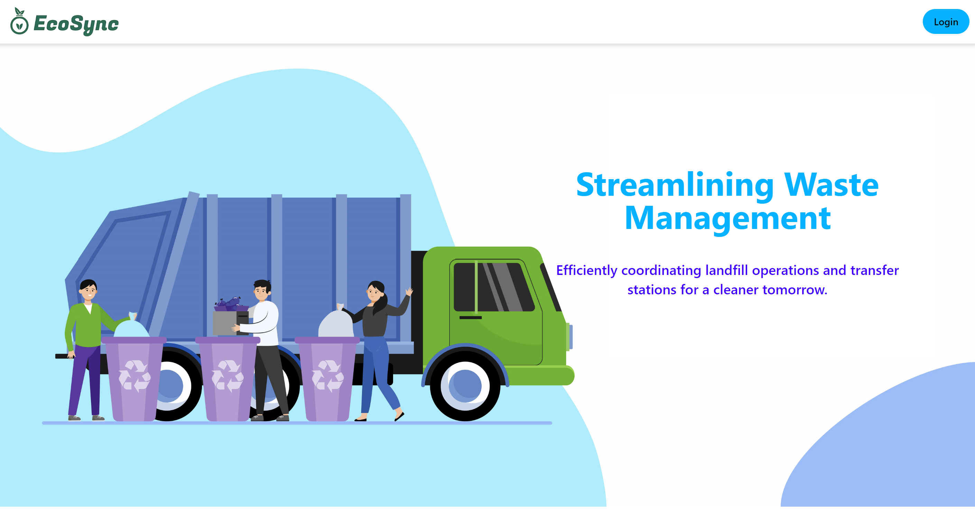
Welcome to Ecosync
“A web application that functions as an administrative panel for various stakeholders involved in the solid waste management process of DNCC.”

Slide 3
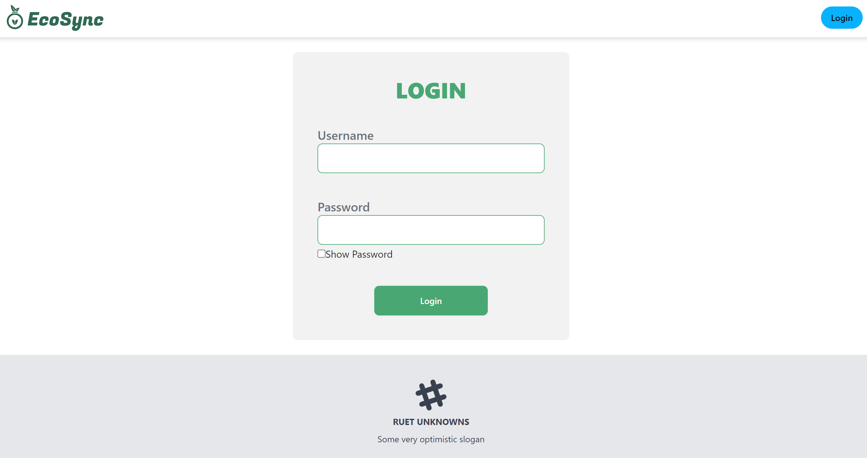
The Login page
Here you can login to different accounts and get access to various activities attached to each sector….
Mainly there are three types of accounts:
1.Admin
2.STS manager
3.Landfill manager

Slide 4
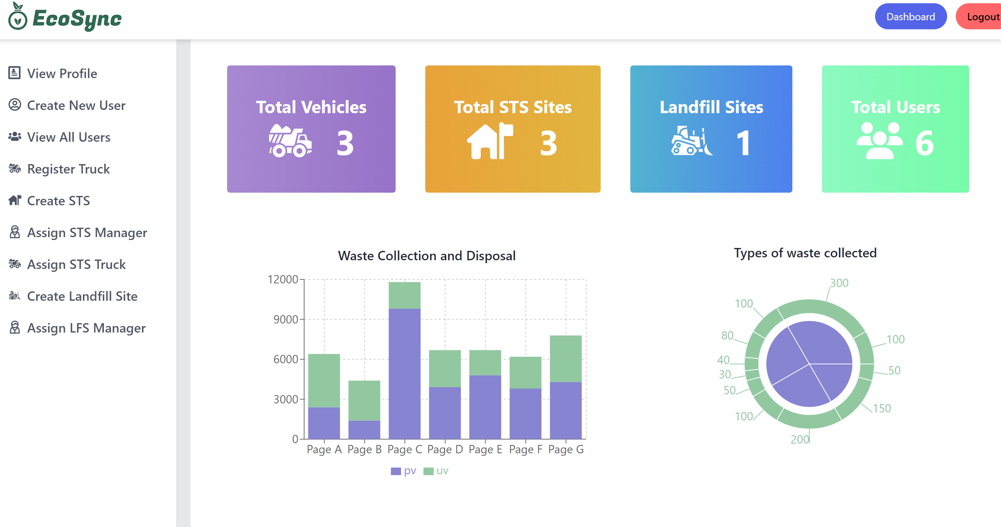
Admin Dashboard view:
As an admin u can see your abilities to the left menubar of your dashboard.

Slide 5
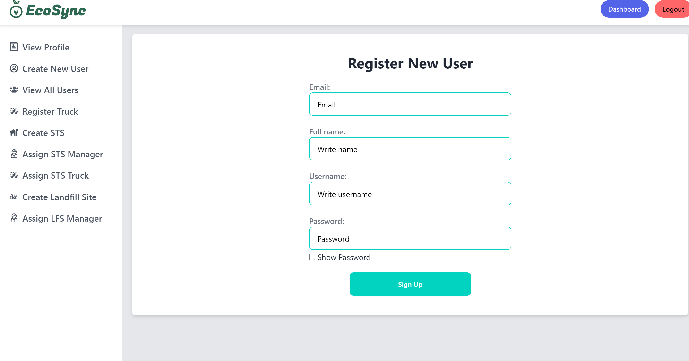
Admin facilities:

Slide 6
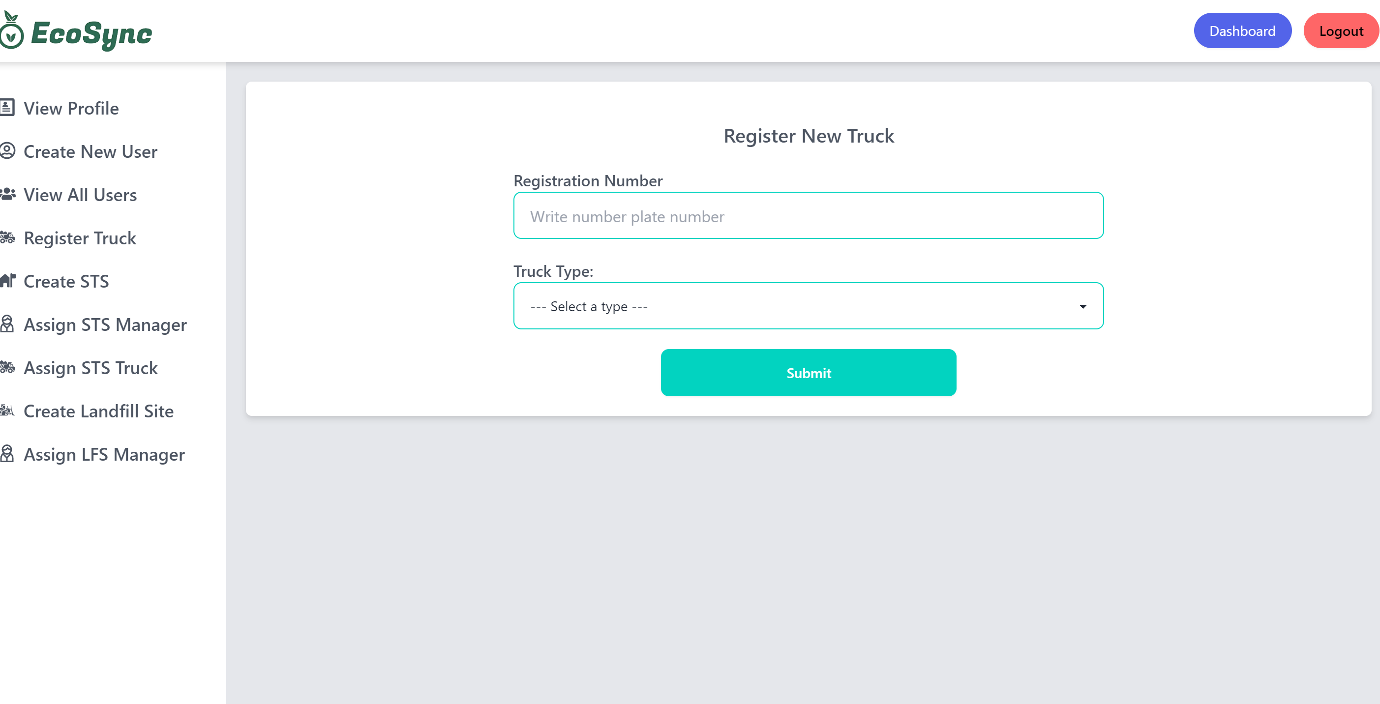
Admin facilities:

Slide 7
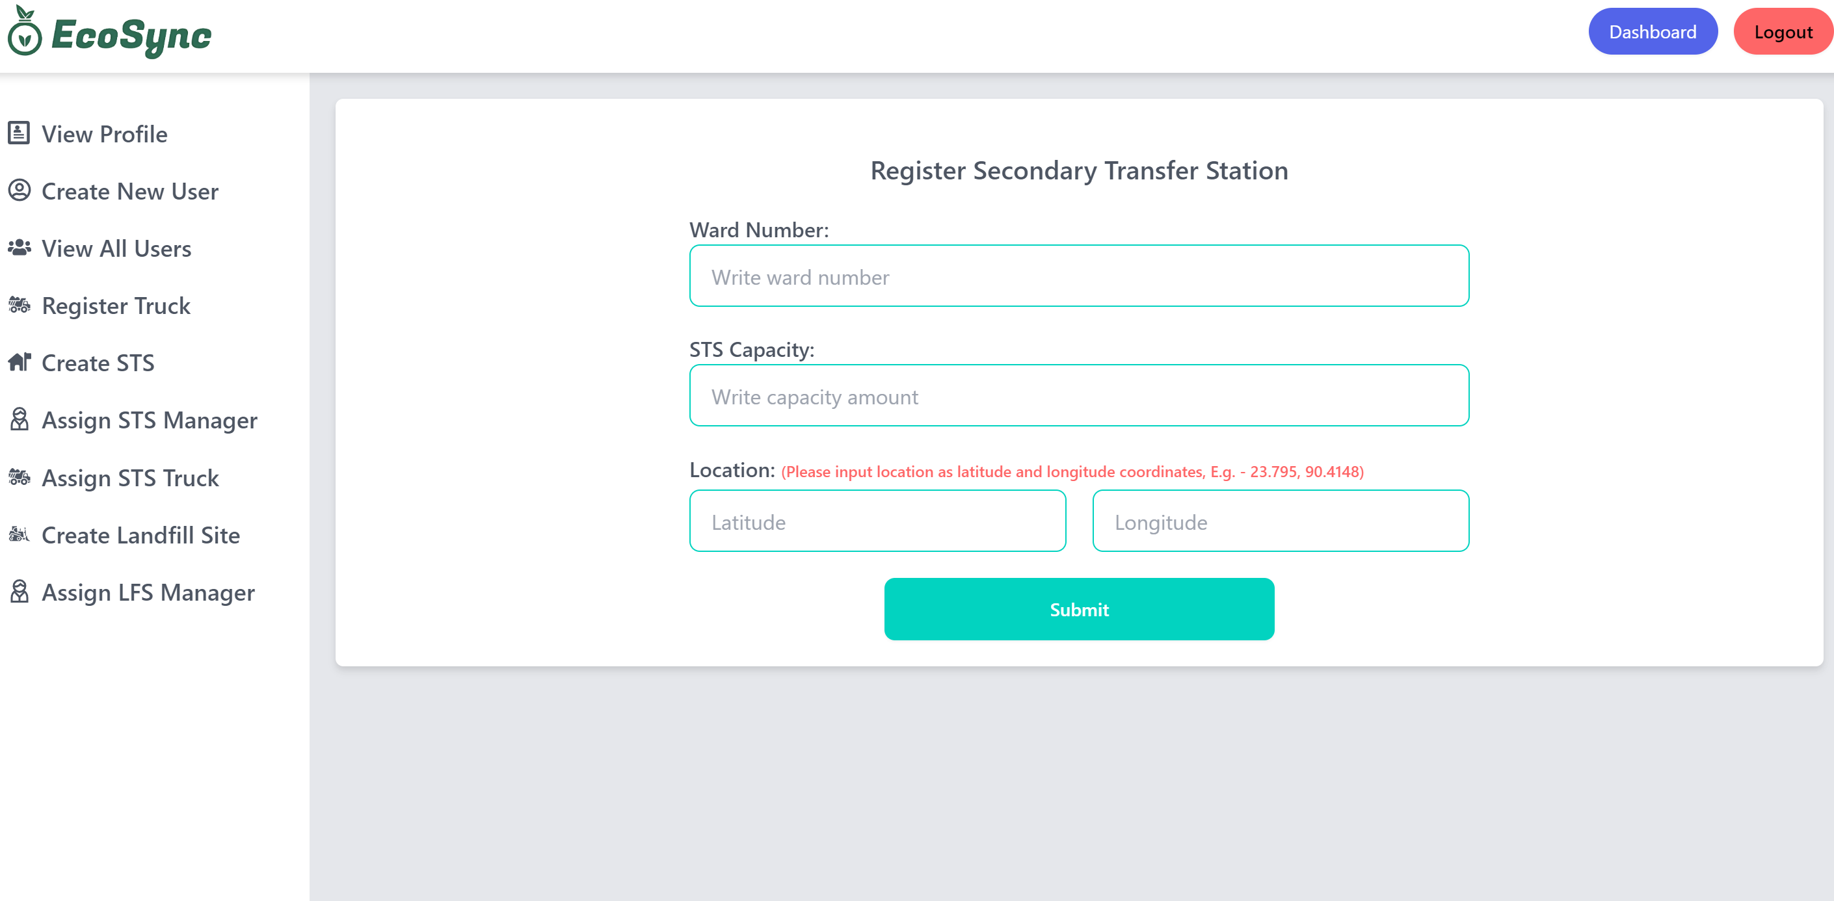
Admin facilities:

Slide 8
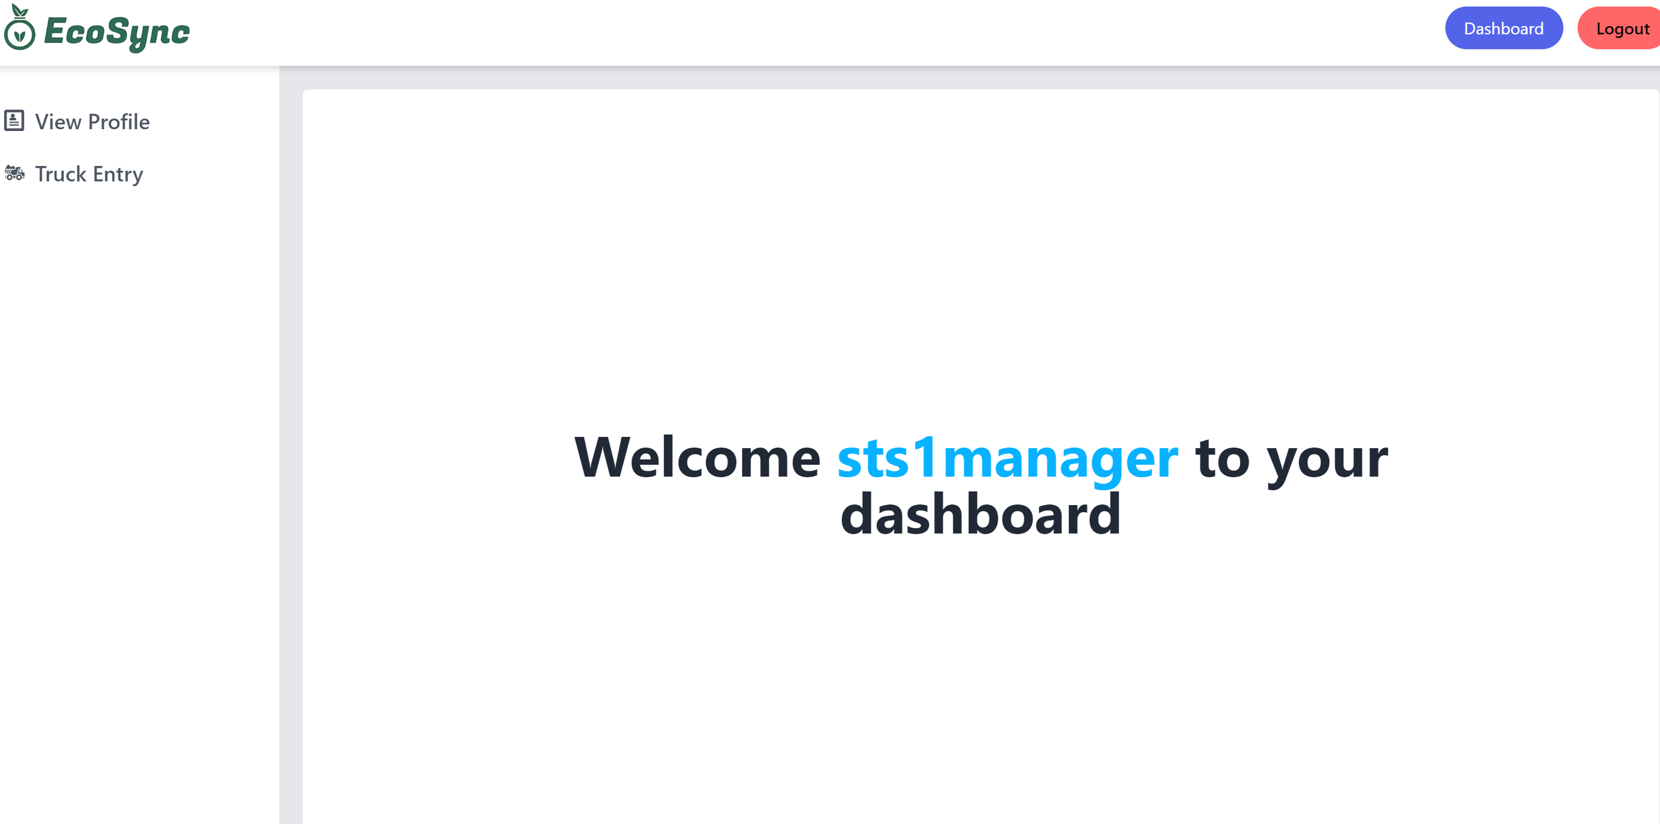
STS manager dashboard:

Slide 9
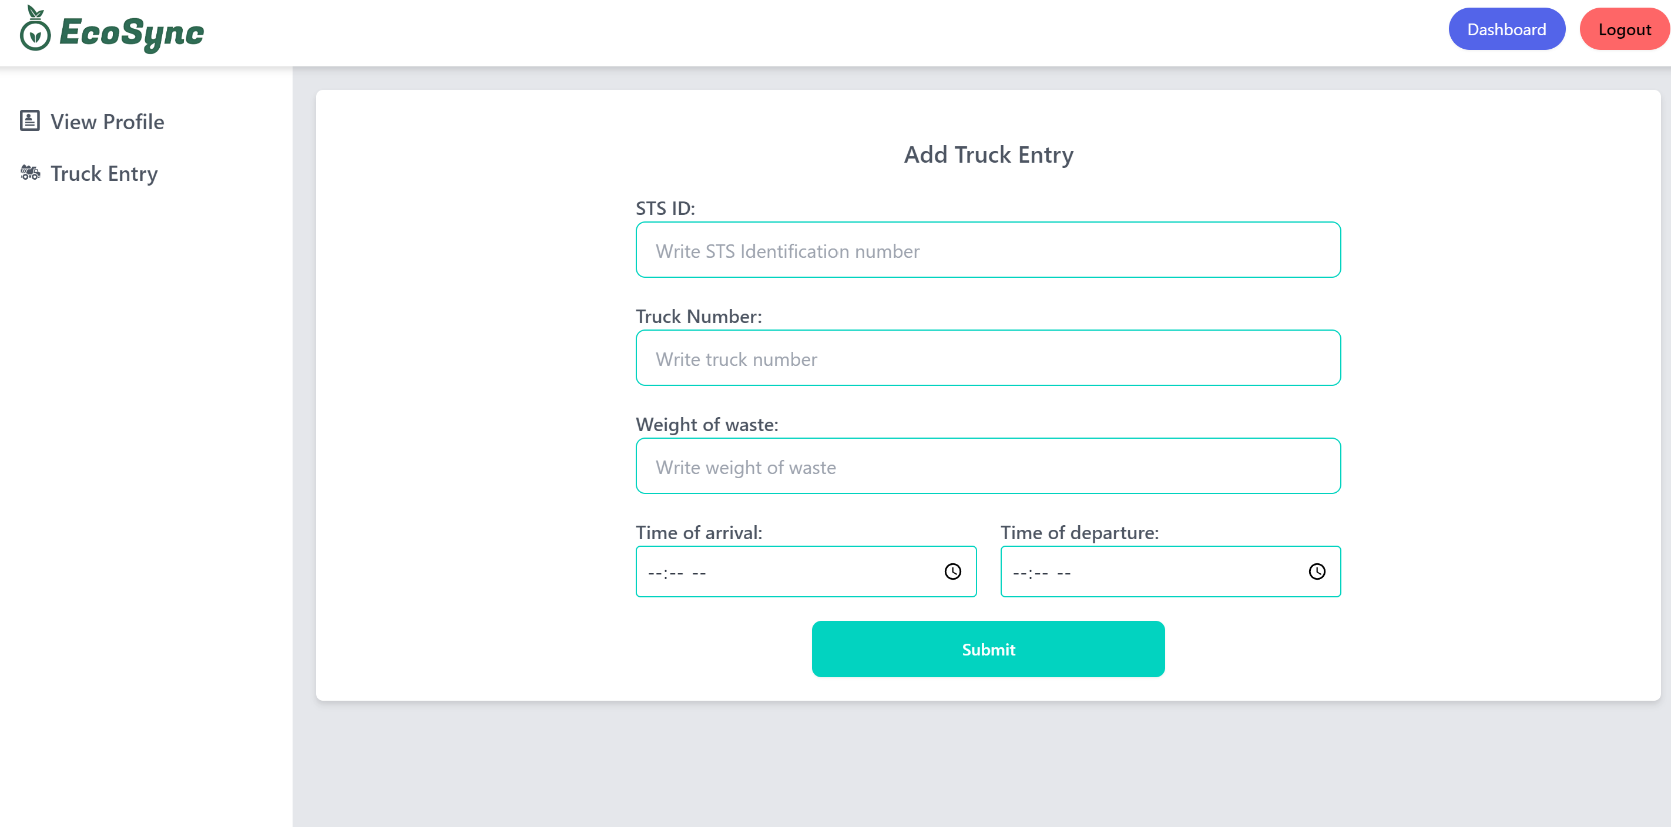
STS manager facilities:

Slide 10
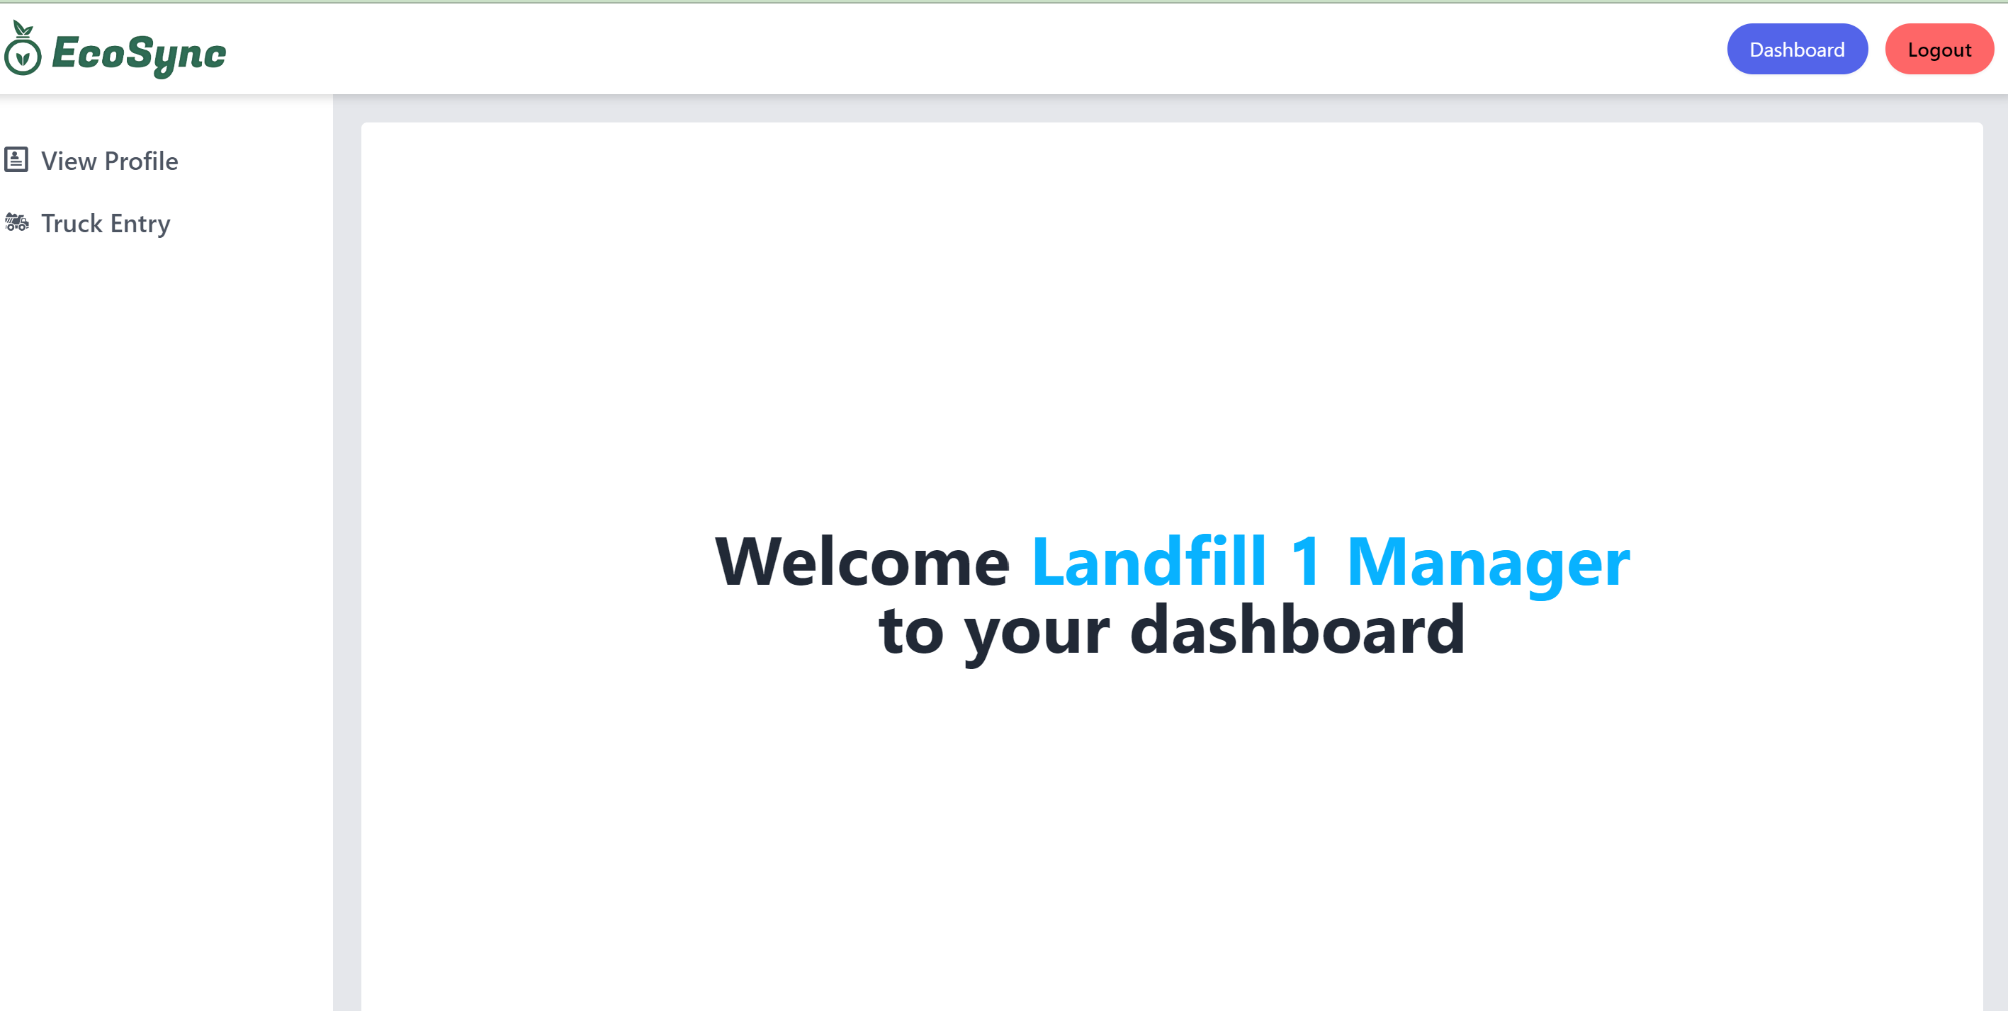
Landfill manager dashboard:

Slide 11
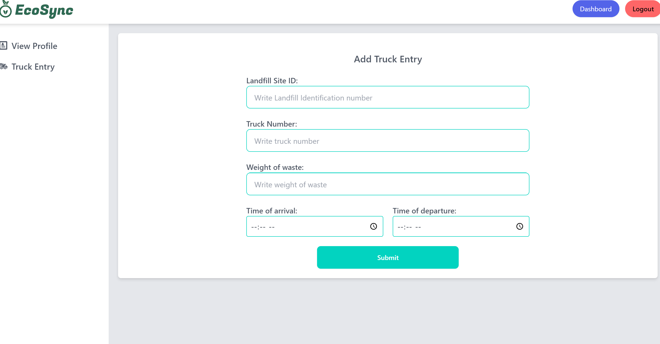
Landfill manager facilities:

Slide 12
THANK YOU
Explore more to know more!

